Slide 1

Python – PySpark Intro
With Synapse Studio

Slide 2
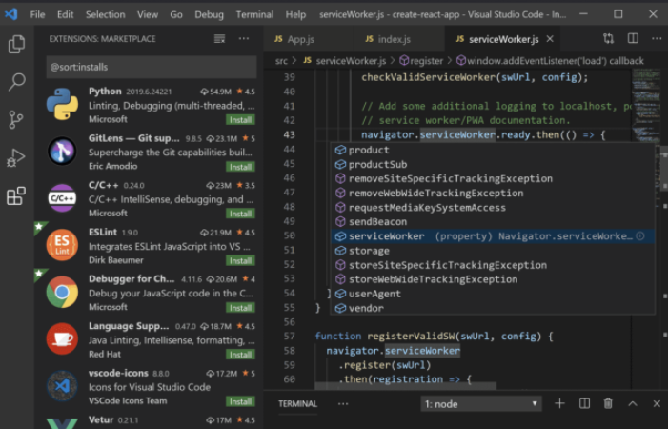
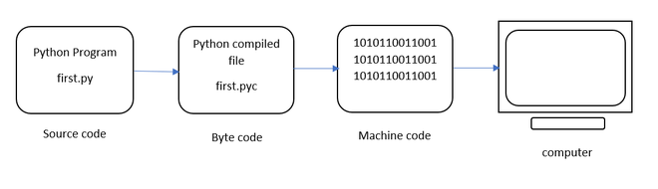
Python Environment Overview

Slide 3
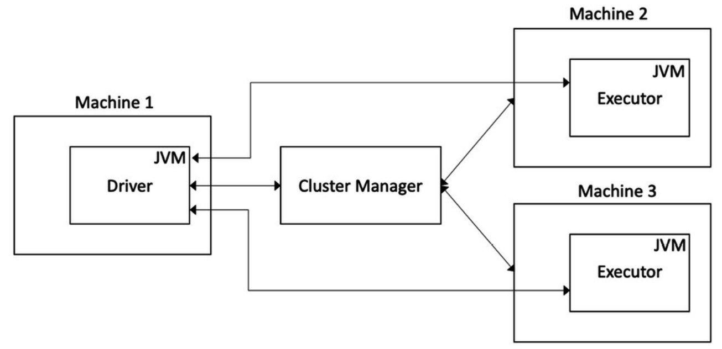
Spark Environment Overview

Slide 4
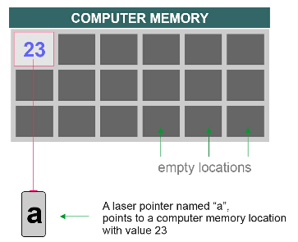
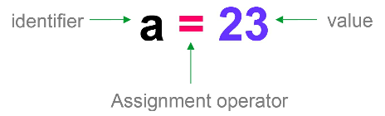
Variables
Best Practices
Start with letter or underscore
Contain only letters, digits, underscores
Can’t use reserved special words

Slide 5
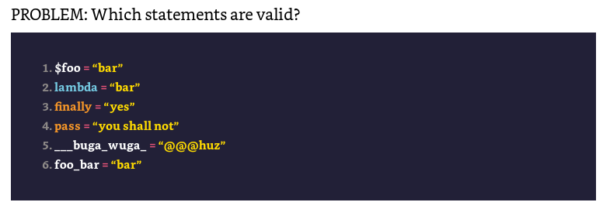
Variables

Slide 6
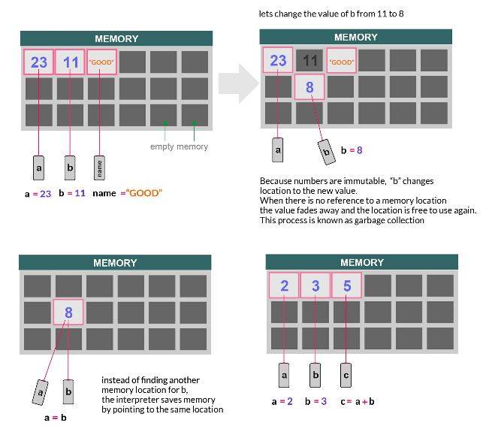
Variables

Slide 7
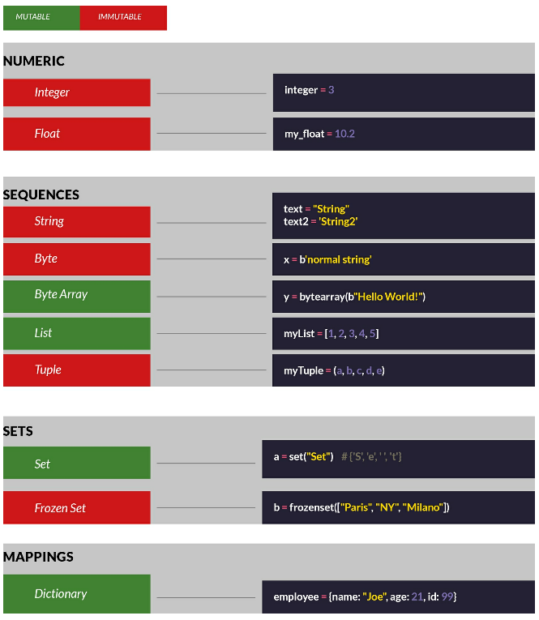
Data Types

Slide 8
Data Types
String str
Integer int
Floating point float
List list - [] mix types array access you can use [-1] for last element and rage notation [2:5]
.append to add elements .insert to add at position .clear to remove all
Dictionary dict - key value pairs {"key":4,"key”:"hello"} mutable
Tuple tuple - like list but are immutable. (1,2,3)

Slide 9
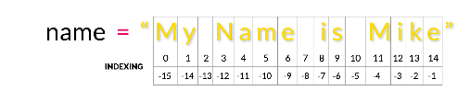
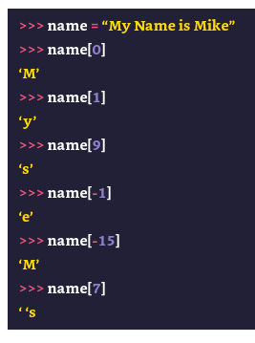
String Considerations
# Examples of valid strings
print("I'm coding!")
print('The computer printed the string "Hello!"')
# Example of invalid string
print("A common phrase in programming is "Hello world"")
# the following two lines print Hello World! to the screen
print('Hello World!’)
print("Hello World")
# the following two lines prints It's a sunny day
print('It\'s a sunny day’)
print("It's a sunny day")
# String Blocks
long_text = “”” Line one
Line 2
Line3
“””

Slide 10
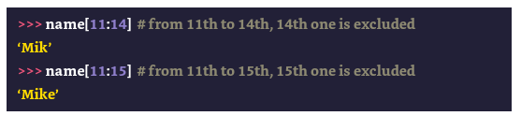
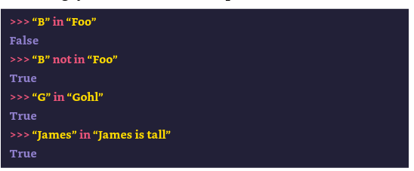
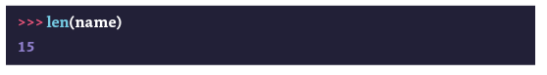
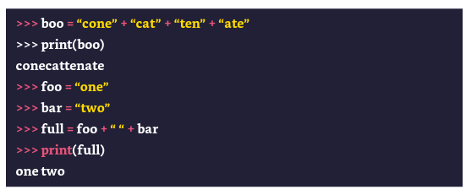
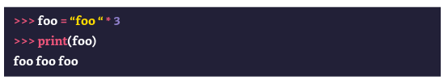
String Considerations

Slide 11
Problem
1) Problem: In Python it is possible to combine multiple strings into one.
What is the name of this operation?
2) There is a string value = “foobar”. You access a substring the following way:
other_value = value[1:3].
What is the name of this operation?
How long is other_value?
3) What is the index of the first character in a string?

Slide 12
Cast (coerce) to another type
Python provides built-in classes, str, int, float, list, dict, and tuple that convert (or coerce) to the appropriate type if needed:
> > > str( 0)
'0'
> > > tuple([ 1,2])
(1, 2)
> > > list('abc')
[‘a', 'b', 'c']

Slide 13
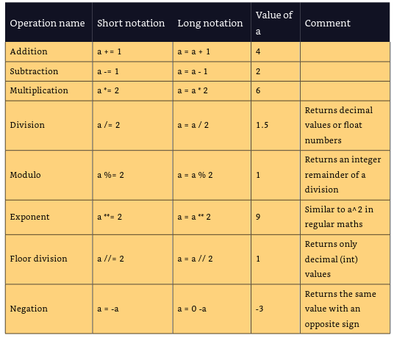
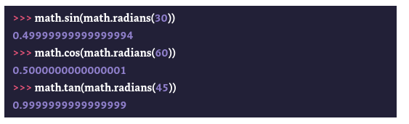
Basic Math

Slide 14
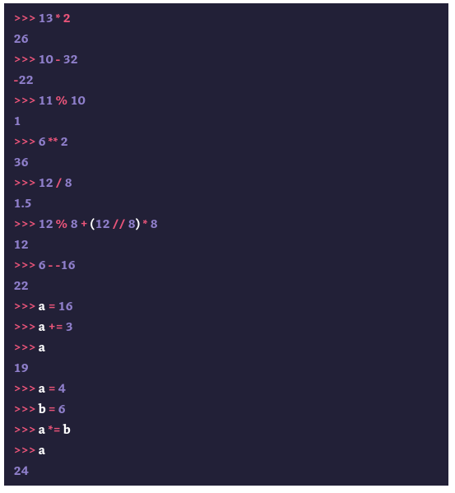
Basic Math

Slide 15
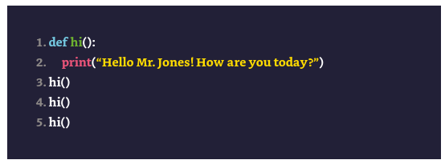
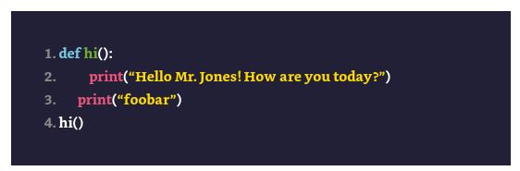
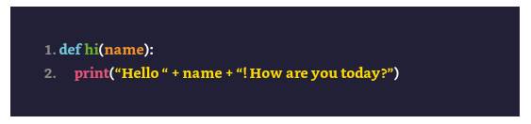
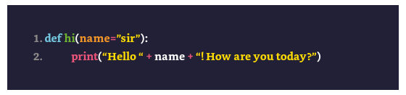
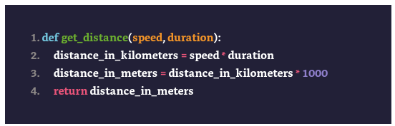
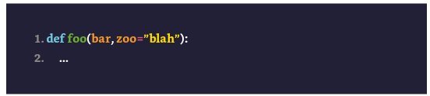
Functions

Slide 16
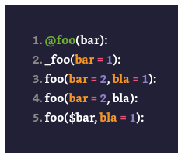
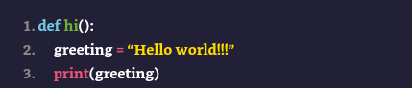
Problem
Change the function below to return
the greeting instead of printing it
What function signatures are valid?

Slide 17
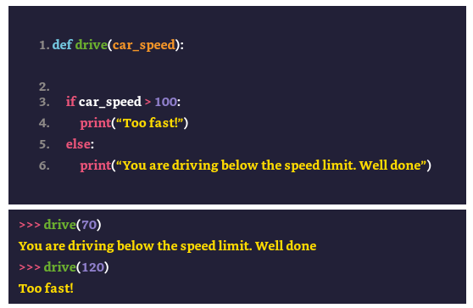
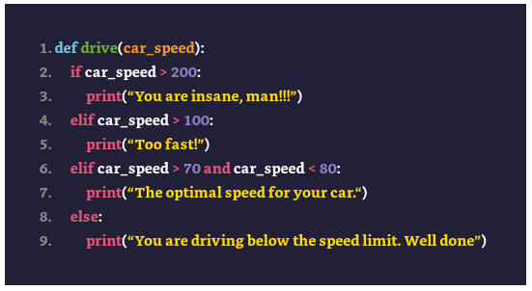
if / else

Slide 18
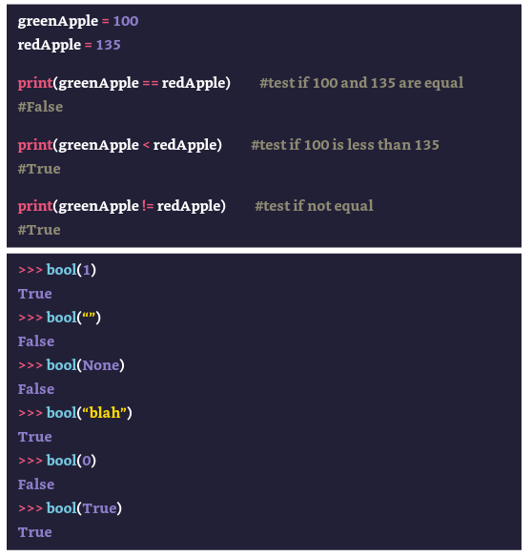
Boolean

Slide 19
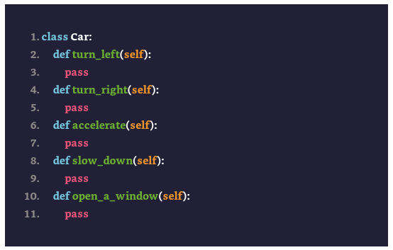
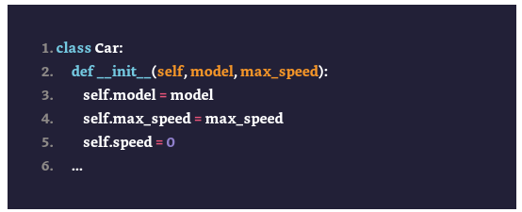
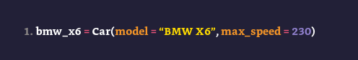
Classes & Objects

Slide 20
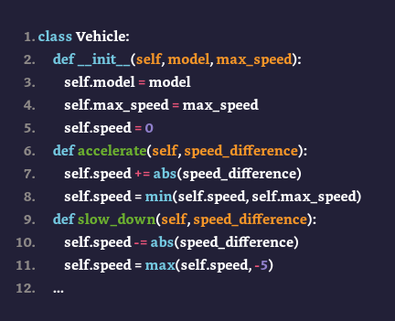
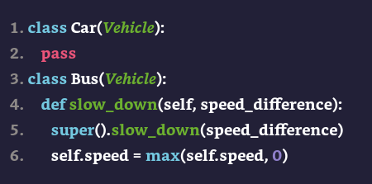
Inheritance

Slide 21
Classes & Objects

Slide 22
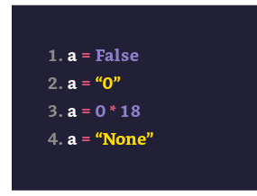
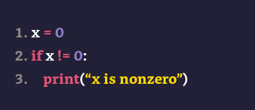
Problem
What is the process called that allows a class to derive another class’ members?
What are the Boolean values for the following variables?
What does the code below print?
What is this method called and why does it exist
__init__(param,param2)
What is wrong with the above code

Slide 23
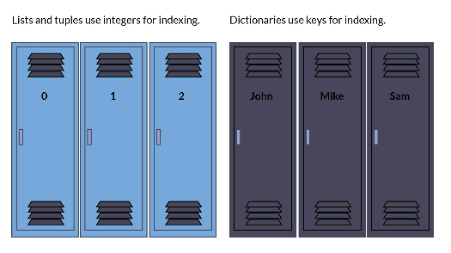
Collections

Slide 24
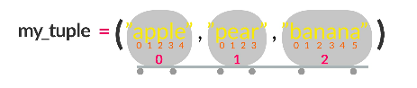
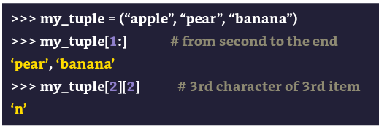
Tuples (immutable array of variables)

Slide 25
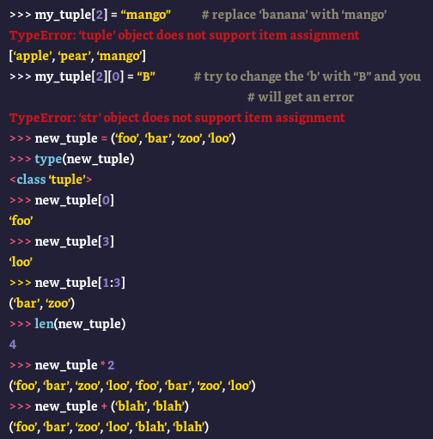
Tuples

Slide 26
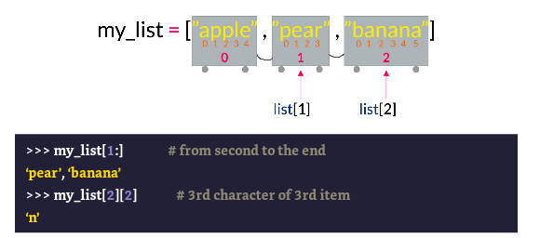
Lists

Slide 27
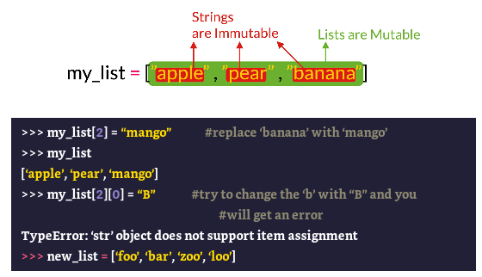
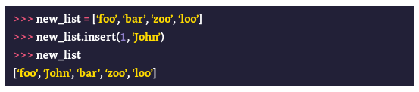
Lists

Slide 28
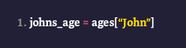
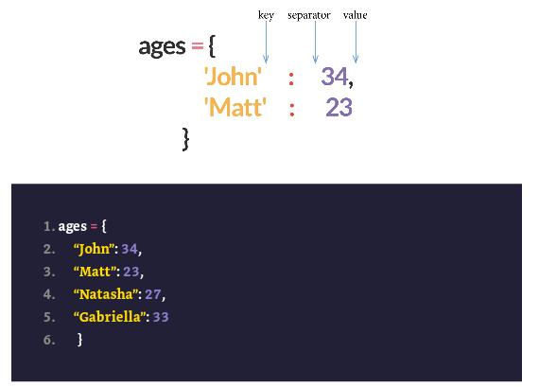
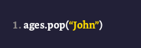
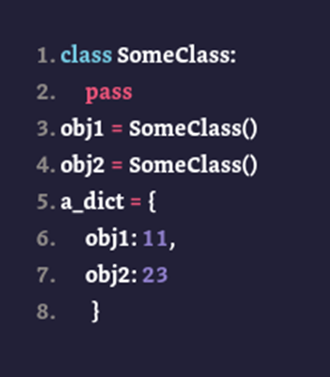
Dictionaries

Slide 29
Problems
What is the main difference between a lists and tuples
Can a float be used as a key in a dictionary
How many keys called “john” can you have in a dictionary
Is this a tuple: (123)

Slide 30
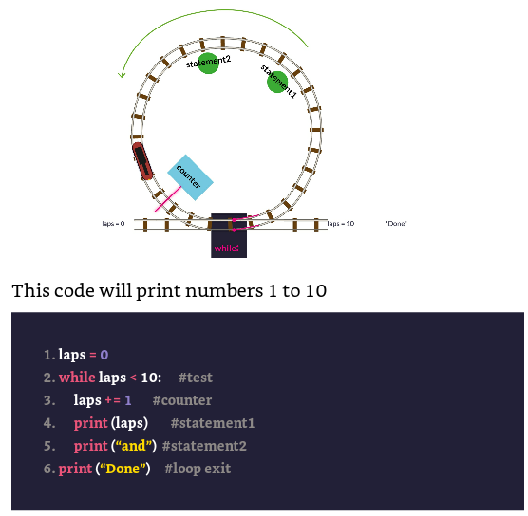
Loops

Slide 31
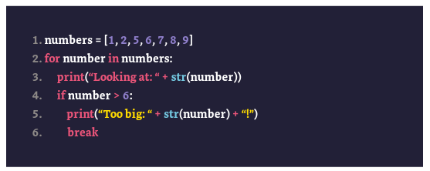
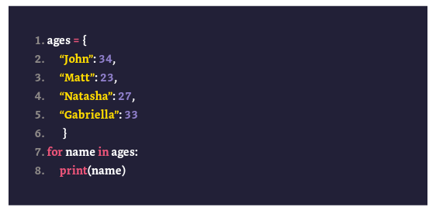
for

Slide 32




File Operations

Slide 33

Exceptions

Slide 34

Modules and Packages

Slide 35

Namespace
Minimize Name Collisions
Organize Larger Code Bases

Slide 36



Import

Slide 37

Anonymous Functions

Slide 38



Functions Part 2
Iterable Unpacking
Pass By Value or Reference (Immutable vs Mutable)
Dictionary Unpacking
Arguments must be passed in the following order:
First, positional arguments: both ordinary (name) and iterable unpacking (*name)
Next come keyword arguments (name=value), which can be mixed with iterable unpacking (*name)
Finally, there is dictionary unpacking (**name), which can be mixed with keyword arguments (name=value)

Slide 39
Abstractions & Separation of Concerns Do one thing and do it well
Programing Styles
Classes
Functions
Modules and Packages
Notebooks calling Notebooks

Slide 40
Performance
Subsystems (CPU, Memory, Disk, Network)
Asyncio (Package for Async Programming)
Multiple Python processes at once

Slide 41
Time Complexity
Linearity – How fast will code perform in relation to its inputs (list, tuple exhibits mainly linear operations)
Proportional to Square – Nested Loops
Constant Time – IDEAL – does not depend on size of inputs, Manifested some built in types (dict, set) for single operations

Slide 42
Space Complexity
Memory – Only read into memory what is necessary
Disk – Read in Async manner if possible. Optimize for underlying hardware and chunk operations as needed

Slide 43


Space Complexity with iterables
Generator Pattern
1) Main Setup
2) Create Loop
3) Yield a value on each interaction of loop
4) Update the state for next interaction

Slide 44
Performance Tools
1) timeit
2) cProfile Python Module usage
python.exe -m cProfile --sort cumtime mycode.py

Slide 45
Testing Your Software
Is the practice of verifying that software behaves the way you expect

Slide 46


Mars Climate Orbiter
Mission
The craft was intended to be the first ever weather satellite for Mars, which would monitor the planet’s atmosphere with its high-resolution camera.
What happened
The craft burned up in the Martian atmosphere
$327.6 million loss for NASA
What went wrong
Bug in the ground control software supplied by a third party
Calculations were performed manually rather than using the supplied software, due to file format errors and miscellaneous bugs
Notes:
CI examples:
At 1:41AM Pacific Time on Thursday, September 23, 1999, the Mars Climate Orbiter stowed its solar arrays, to protect them from a temporary descent into the upper Martian atmosphere. Nine minutes later, the craft reoriented itself using its Reaction Control systems, to line up its main engine retrograde to Mars. At 2:01AM, the engine ignited for its main burn, which initiated a 40 day stretch of complex aerobraking maneuvers in the upper Martian atmosphere, conserving precious rocket fuel. At 2:06AM, the orbiter passed behind Mars, and radio communications from Earth were blocked for a nail-biting twenty-one minutes.
Once having successfully entered orbit, the satellite was supposed to relay photos of Mars to Earth for several years.
But unfortunately, this did not happen as the craft was not on the correct trajectory. Instead, it had burned up in the Martian atmosphere nearly 24 hours earlier, lost without a trace. This is the story of the Rapid Unanticipated Disassembly of the Mars Climate Orbiter.
Ground Control software
A bug in the ground control software supplied by Lockheed Martin, which displayed the force for each AMD maneuver. The software calculated the value in an imperial unit, pound-seconds, whereas the software built by NASA expected the value to be in a metric unit, newton-seconds. As these values were not correctly converted, this led to small discrepancies in the position of the spacecraft, which compounded over a course of millions of miles.
Human error
Quality Assurance had not found the use of an imperial unit in external software, despite the fact that NASA’s coding standards at the time mandated use of metric units.
In fact, for the first four months of navigation, NASA had relied on email notifications from the contractor to determine that the spacecraft was rotating. Calculations were also performed manually rather than using the supplied software, due to file format errors and miscellaneous bugs.
Why the Mars Probe went off course - IEEE Spectrum

Slide 47
Functional Testing
Prepare Inputs
Determined by you or software author
Identify Expected Outputs
Determined by you or software author
Obtain Actual Outputs
Compare actual to expected
Determined by executing real code
If the same:Pass Different:Fail
Manual
Automated
Acceptance

Slide 48
Testing Granularity
BDD
Integration
Unit Testing

Slide 49
Unit Testing
Most Granular
Functions are the most common target of functional tests
Fundamental to success in larger testing efforts

Slide 50
Integration Testing
Make sure Units work together
Usually fewer of them
Common to structure much like code they are created to test (tight coupling)
Longer to execute

Slide 51
Regression Testing
Less of an approach and more of a process to follow
I want to make sure the code keeps working this way – if you change your code and that changes the behavior, that will lead to regression.
A regression is a shift to the undesirable

Slide 52

End to End Testing (BDD) Behavioral Driven Development

Slide 53
Python unittest and pytest module
Python –m unittest
Looks for tests in current directory or or subdir for modules named test_* or *_test
pytest

Slide 54
TDD & Chaos testing
Mindset
Netflix Chaos Engineering https://netflixtechblog.com/tagged/chaos-engineering

Slide 55
Analyzing Data With PySpark

Slide 56
Indications
Python on Spark (slightly just slightly slower than Scala)
Access to:
Spark API
Bespoke(Custom) to scale-out regular Python Code
Scale-out pandas transformations

Slide 57
Contra-Indications
Rapid processing of very small data sets
Slightly slower than Scala/Java native code
RDD usage
UDF (user defined functions)
*Not a deal breaker

Slide 58
Contra-Indications
Rapid processing of very small data sets
Slightly slower than Scala/Java native code
RDD usage
UDF (user defined functions)
*Not a deal breaker

Slide 59

Spark Jargon
Master
Executors
Node 1
Spark-Context
Node 4

Slide 60


Distributed Example

Slide 61
More Jargon
master allocates resources
driver is responsible for completing a given job (translates to Spark steps)
worker is a set of cpu/mem resources (Workbench)
executors run on workers to do work given by driver

Slide 62
Efficiently Lazy
PySpark will NOT perform work until it sees write()
In contrast normal python and pandas will tend to be eager
Every instruction you send to Spark is either:
Transformations – Everything not an action (adding a column, aggregation, training DS model)
Actions (IO operations – print to screen, write to disk..)
show()
write()
count()

Slide 63

Efficiently Lazy

Slide 64
SparkSession
PySpark uses a builder pattern through the SparkSession.builder object.
Wraps SparkContext and provide functionality for interacting with Spark SQL API

